Slide 1
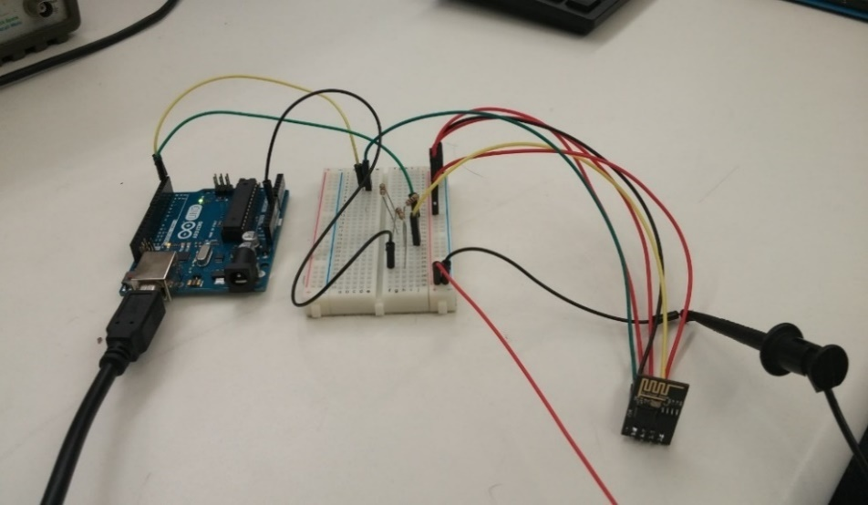
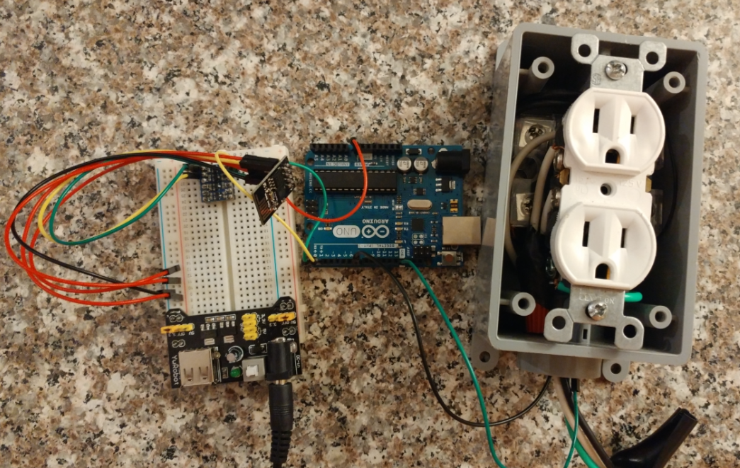
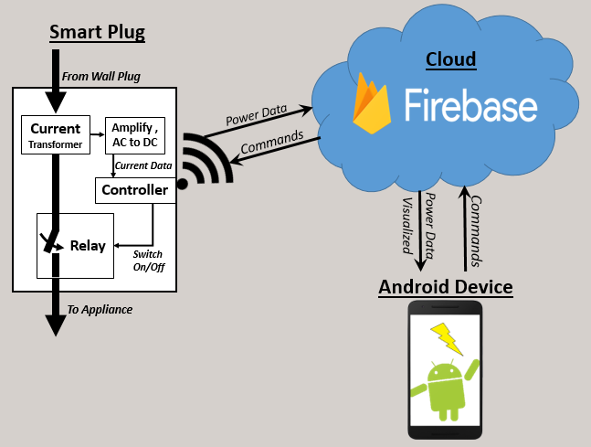
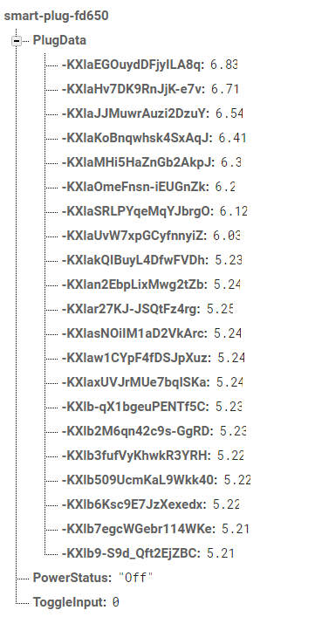
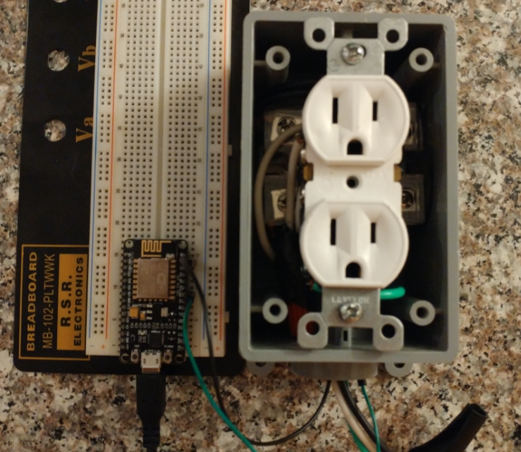
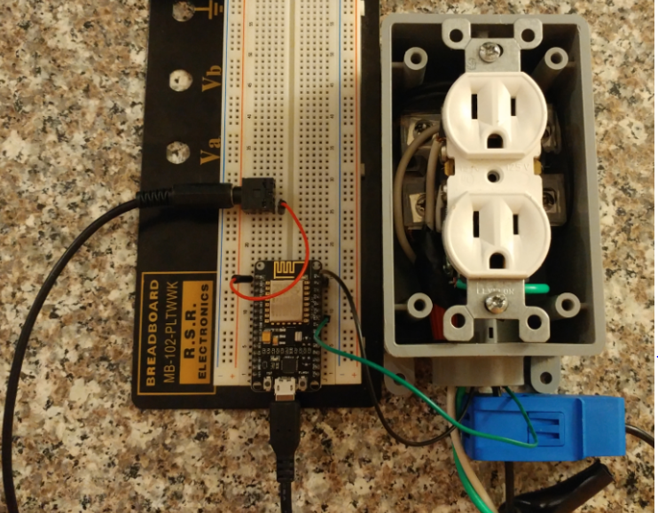
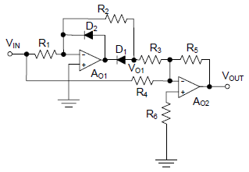
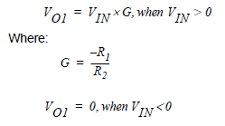
The Smart Plug An Energy Monitoring and Management Solution
Division of Engineering Programs
Senior Design Project II
Fall 2016
Project Description
120Vac appliance plug attachment
Allows remote control of
power to appliance from Android Device
Sends Real-time power data
to Android Device
Design Iterations
Arduino Uno &
ESP8266-01
-Poor Communication due to different Logic Voltages (3.3V – 5V).
Daniel Putterman, Dr. Baback Izadi, Alex Alderman, Dr. Nitya Narasimhan
Arduino Uno &
ESP8266-01 w/ Logic Level Convertor
-Better communication, but
too much data loss.
Computer Engineer Advisor Electrical Engineer Advisor
Constraints
Minimal cost, using free software
Reduce energy consumption
Extends appliance life by limiting power
Safe materials in accordance with the National Safety Code (NESC) and National Fire Protection Agency(NFPA) regulations
ESP8266-12e
-No Communication issues. Able to activate test-bench power relay
ESP8266-12e
-Included SCT-013-030 Current Transformer.
Signal amplification and rectification needed.
Engineering Background & Theory
Sampling Theory:
Nyquist: $f= \frac{F}{f_{s}}$, $.5= \frac{60hz}{f_{s}}$,$f_{s}=120hz$
C & Java Programming
Electronics Design:
$P=V∗I$
Amplifier Design: Full-Wave Rectifier
Final Design
Implemented using ESP8266-12e
microcontroller (Xtensa CPU)
Appliance Current measured with
Current Transformer
Google Firebase used to hold data
Custom App for sending commands
and receiving data
2 Stage Op-Amp
Full Wave Rectifier
References: "Op Amp Rectifiers, Peak Detectors, and Clamps", Microchip Technology, 2016. [Online].
Available: http://ww1.microchip.com/downloads/en/AppNotes/01353A.pdf. [Accessed: 30- Nov- 2016].

